Slide 1
Markov Chain

Slide 2
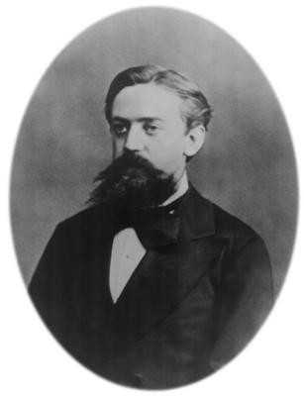
Markov Chain :
a process with a finite number of states (or outcomes, or events) in which the probability of being in a particular state at step n + 1 depends only on the state occupied at step n.
Prof. Andrei A. Markov (1856-1922) , published his result in 1906.

Slide 3
If the time parameter is discrete {t1,t2,t3,…..}, it is called Discrete Time Markov Chain (DTMC ).
If time parameter is continues, (t≥0) it is called Continuous Time Markov Chain (CTMC )

Slide 4
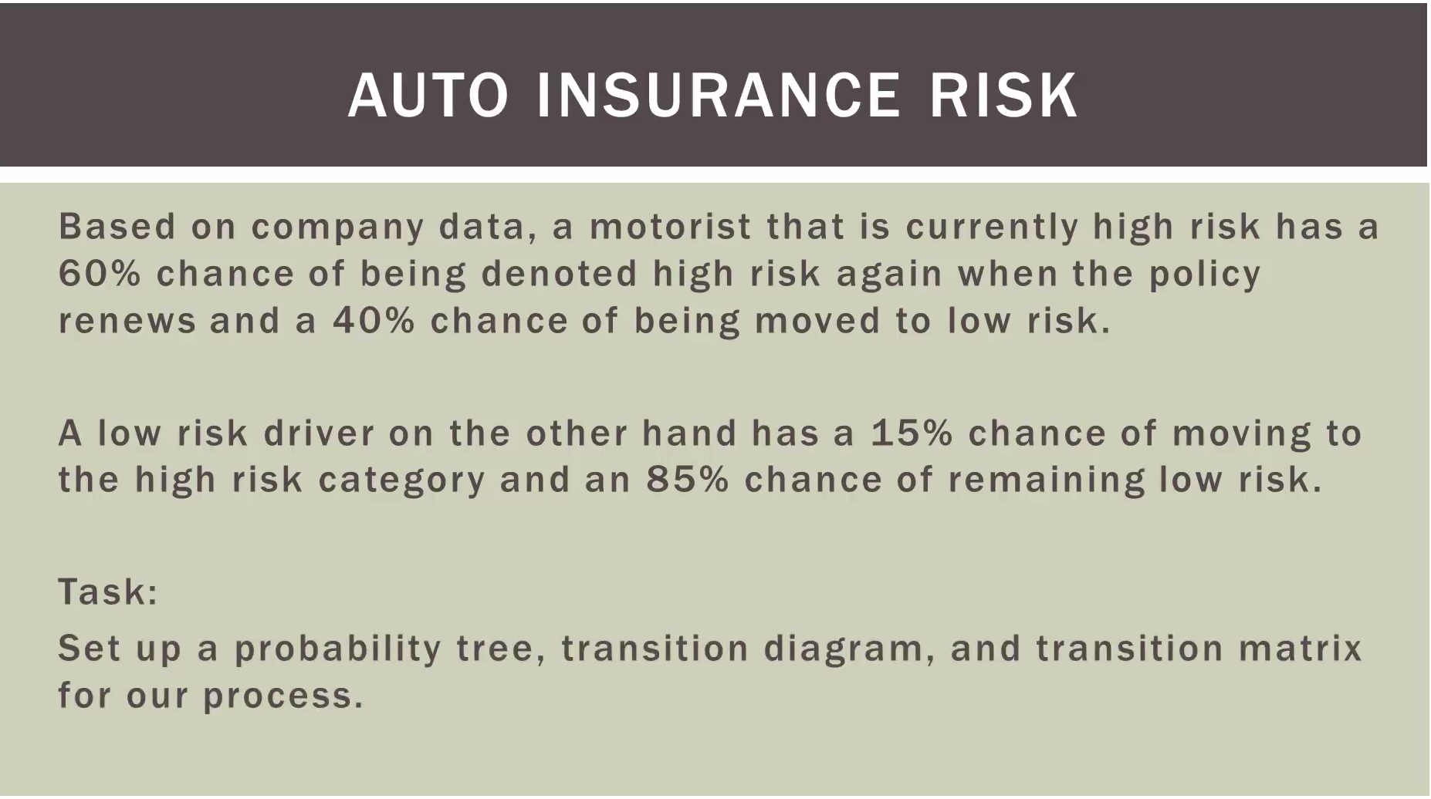
http://www.bcfoltz.com/blog/mathematics/finite-math-introduction-to-markov-chains

Slide 5
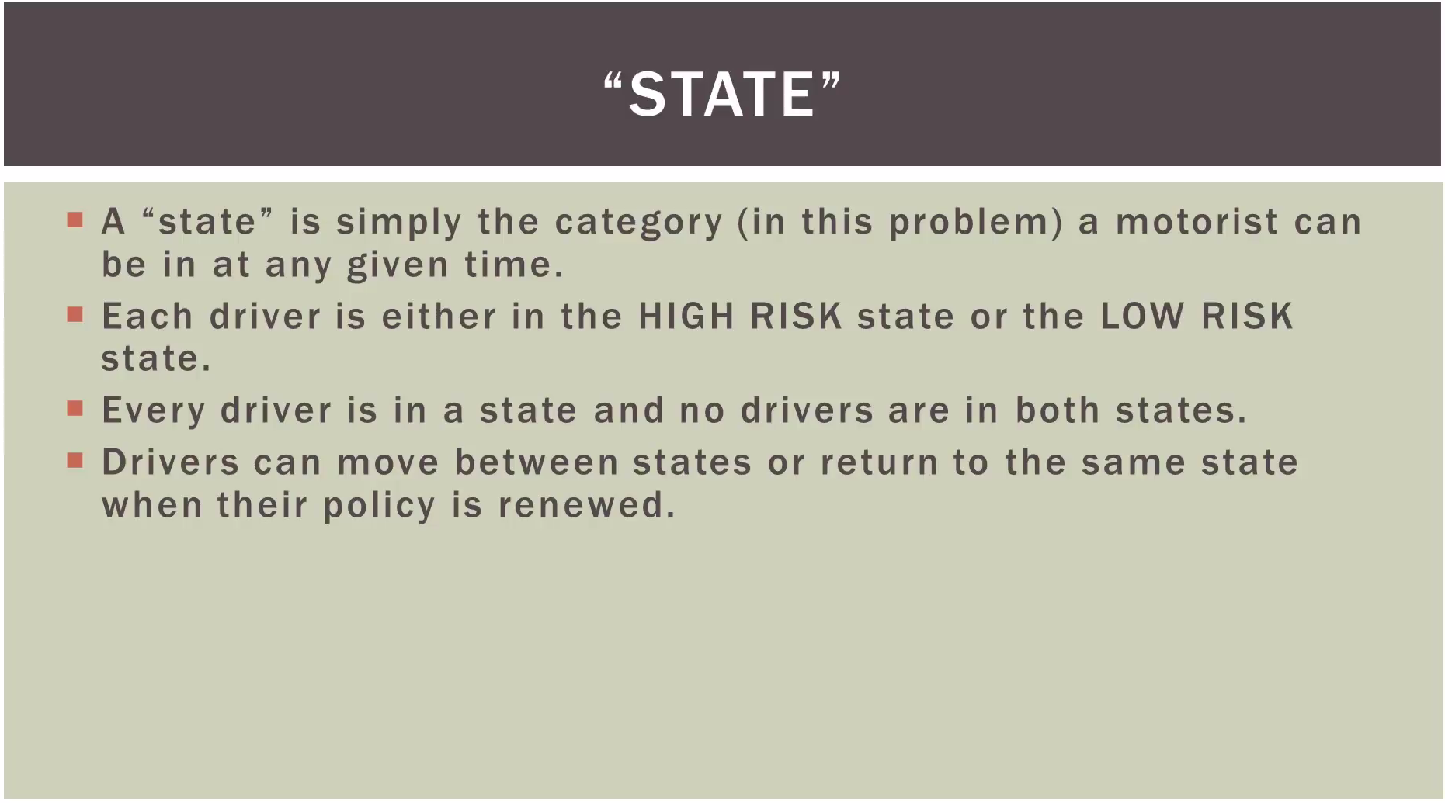
http://www.bcfoltz.com/blog/mathematics/finite-math-introduction-to-markov-chains

Slide 6
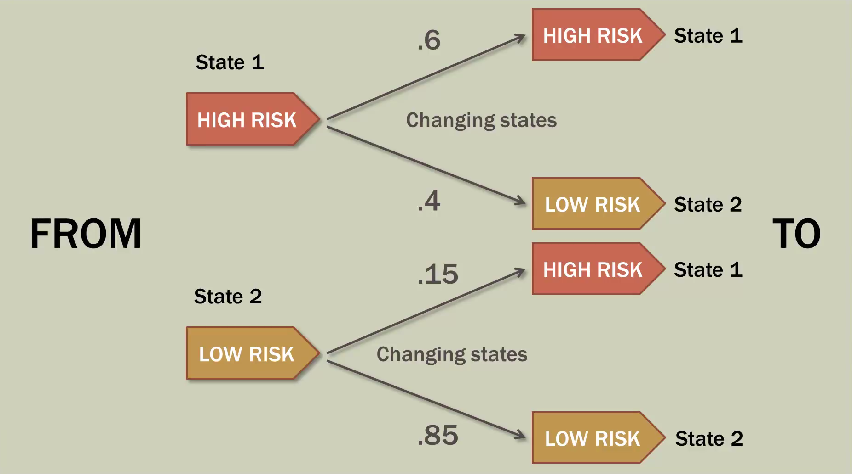
http://www.bcfoltz.com/blog/mathematics/finite-math-introduction-to-markov-chains

Slide 7
Markov chain key features:
A sequence of trials of an experiment is a Markov chain if:
1. the outcome of each experiment is one of a set of discrete states;
2. the outcome of an experiment depends only on the present state, and not on any past states.

Slide 8
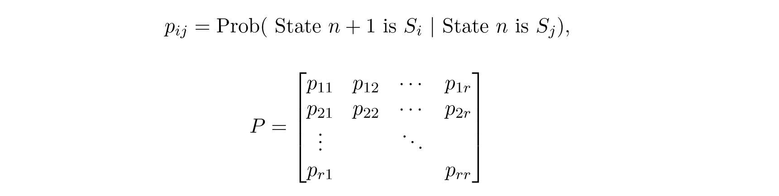
Transition Matrix : contains all the conditional
probabilities of the Markov chain
Where Pij is the conditional probability of being in state Si at step n+1 given that the process was in state Sj at step n.

Slide 9
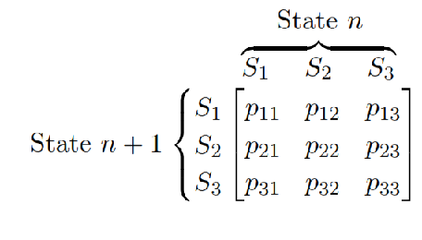
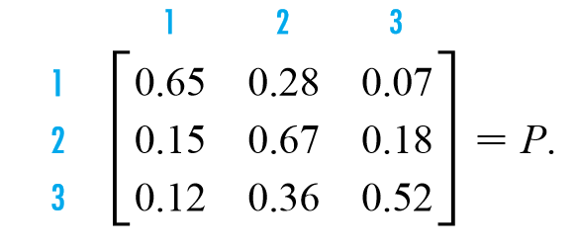
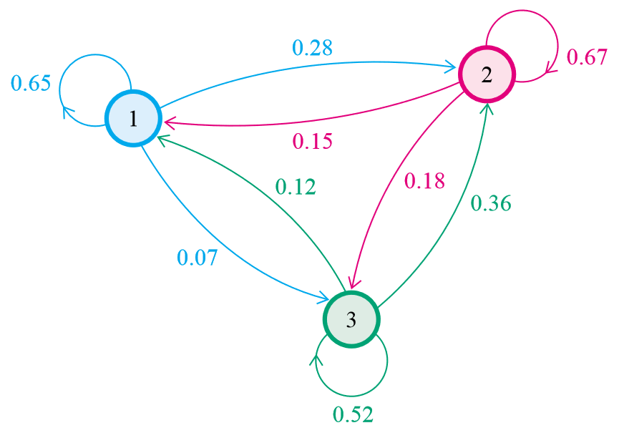
Example:
http://www.math.bas.bg/~jeni/markov123.pdf

Slide 10
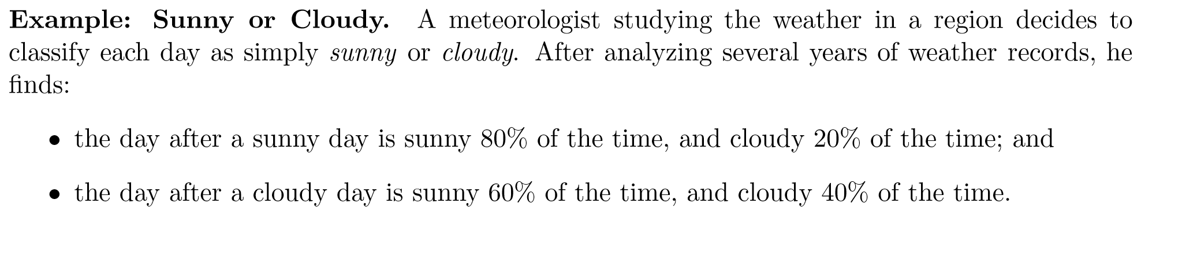
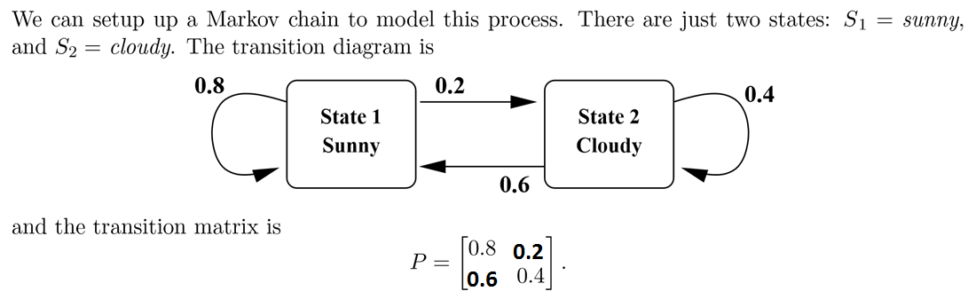

Slide 11
Transition matrix features:
It is square, since all possible states must be used both as rows and as
columns.
All entries are between 0 and 1, because all entries represent probabilities.
The sum of the entries in any row must be 1, since the numbers in the row give the probability of changing from the state at the left to one of the states indicated across the top.

Slide 12
special cases of Markov chains:
regular Markov chains:
A Markov chain is a regular Markov chain if some power of the transition matrix has only positive entries. That is, if we define the (i; j) entry of P^{n} to be p^{n}_{ij} , then the Markov chain is regular if there is some n such that p^{n}_{ij}> 0 for all (i,j).
absorbing Markov chains:
A state S_{k} of a Markov chain is called an absorbing state if, once the Markov chains enters the state, it remains there forever.
A Markov chain is called an absorbing chain if
It has at least one absorbing state.
For every state in the chain, the probability of reaching an absorbing state in a finite number of steps is nonzero.

Slide 13
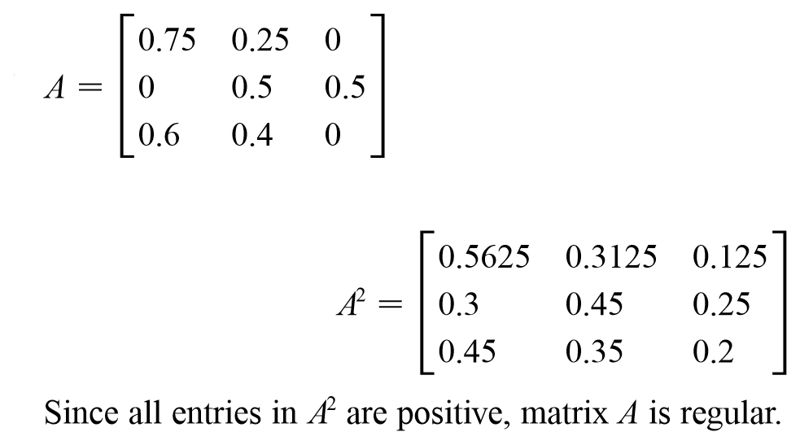
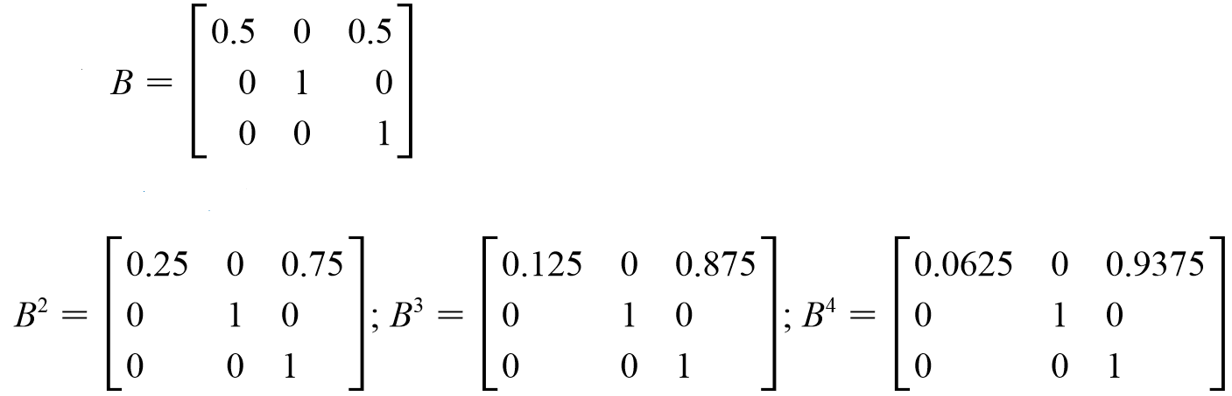
Examples:
Regular
Not regular

Slide 14
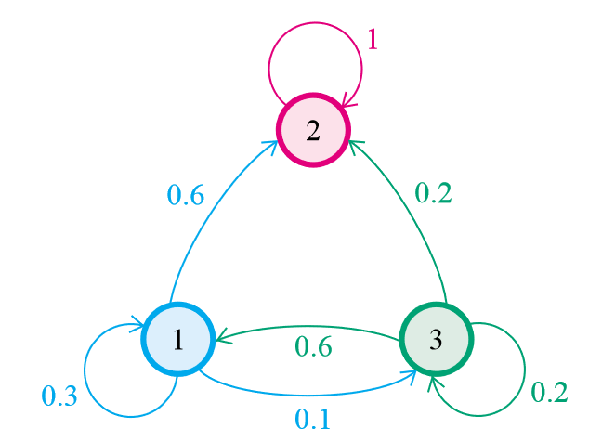
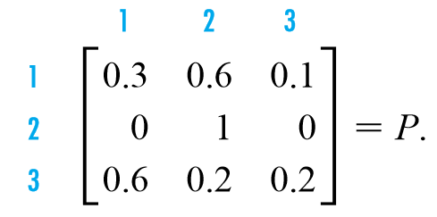
Examples : Absorbing
State 2 is absorbing
Pii = 1 → P22 = 1
http://www.math.bas.bg/~jeni/markov123.pdf

Slide 15
Irreducible Markov Chain:
A Markov chain is irreducible if all the states communicate with each other, i.e., if there is only one communication class.
i and j communicate if they are accessible from each other. This is written i↔j .

Slide 16
Some applications:
Physics
Chemistry
Testing: Markov chain statistical test (MCST), producing more efficient test samples as replacement for exhaustive testing
Speech Recognition
Information sciences
Queueing theory: Markov chains are the basis for the analytical treatment of queues. Example of this is optimizing telecommunications performance.
Internet applications: The PageRank of a webpage as used by google is defined by a Markov chain , states are pages, and the transitions, which are all equally probable, are the links between pages.
Genetics
Markov text generators: generate superficially real-looking text given a sample document,, example: In bioinformatics, they can be used to simulate DNA sequences

Slide 17
Q & A

Slide 18
Questions
Q1: What is Markov Chain ? Give an example of 2 states .
Q2: Mention its types according to the time parameter.
Q3: What are the key features of Markov chain ?
Q4: What is the transition matrix ? Give 3 of its features .
Q5: Give an example of how can Markov Chain helps internet applications .
Q6: how can we know if Markov Chain is regular or not ?

Slide 19
References
http://ir.nmu.org.ua/bitstream/handle/123456789/120287/87b82675190b8afe334c0caa4e136161.pdf?sequence=1
http://math.colgate.edu/~wweckesser/math312Spring05/handouts/MarkovChains.pdf
http://www.math.bas.bg/~jeni/markov123.pdf
http://www.bcfoltz.com/blog/mathematics/finite-math-introduction-to-markov-chains
http://webdiis.unizar.es/asignaturas/SPN/material/DTMC.pdf
https://www.youtube.com/watch?v=tYaW-1kzTZI
http://dept.stat.lsa.umich.edu/~ionides/620/notes/markov_chains.pdf

